Slide 1
Write AI - Handwritten Text Recognition Using Neural Networks
Team Members : Project Guide :
Allen Y TVE19CS011 Dhanya S Pankaj
Alvin Antony TVE19CS012
Ardra T S TVE19CS018
Krishnapriya V P LTVE19CS070

Slide 2
CONTENTS
INTRODUCTION
LITERATURE SURVEY
GAPS IDENTIFIED
PROBLEM STATEMENT
OBJECTIVES
SYSTEM DESIGN
IMPLEMENTATION SETUP FRAMEWORK
IMPLEMENTATION RESULT
INDIVIDUAL CONTRIBUTIONS
CONCLUSION AND FUTURE WORKS

Slide 3
INTRODUCTION
People still choose to take their notes traditionally: with pen and paper.
Difficulty in storing and accessing physical documents in an efficient manner.
Most of important knowledge gets lost or does not get reviewed because they never get transferred to digital format.
We have thus decided to tackle this problem in our project because of the significantly greater ease of management of digital text compared to written text .

Slide 4
Aims to further explore the task of classifying handwritten text and to convert handwritten text into the digital format.
We aim to classify images of any handwritten text, which might be of the form of cursive or block writing.
Develop a fully functional model that would help the user solve the problem of converting handwritten documents into digital format.

Slide 5
LITERATURE SURVEY
As a part of our literature survey, we have studied the following approaches
The purpose of this review is to identify the most commonly used data sources, feature extraction methods, and classification algorithms employed in this field.
Their features and shortcomings have been summarized respectively

Slide 6
Publication: Johannes Michael, Roger Labahn, Tobias Grüning, Jochen Zöllner“EVALUATING SEQUENCE-TO-SEQUENCE MODELS FOR HANDWRITTEN TEXT RECOGNITION” | Methodology Proposed: The attention-based Seq2Seq model follows the standard encoder-decoder framework with attention. It achieves competitive results on the IAM and ICFHR2016 READ datasets The encoder combines a CNN with recurrent layers to introduce temporal context in the feature representation. The decoder utilizes a recurrent layer to interpret the feature representation. The attention mechanism allows the decoder to focus on the most relevant encoded features during each decoding time step
Advantages: Handling variable-length inputs Capturing contextual information. End-to-end training. Versatility in various tasks within handwritten text recognition. | Disadvantages: Large training data requirements. Computational resource demands. Lack of interpretability. Susceptibility to overfitting

Slide 7
Publication: Savita Ahlawat, Amit Choudhary “Hybrid CNN-SVM Classifier for Handwritten Digit Recognition” | Methodology Proposed: The proposed approach introduces a hybrid CNN-SVM model designed for the classification of handwritten digits in the MNIST dataset. Utilizing a Convolutional Neural Network (CNN), the system leverages its capability to extract distinctive features from raw digit images. To extract the most prominent features, a 5x5 kernel/filter is applied in the convolutional layer. The CNN's softmax layer is replaced by a Support Vector Machine (SVM) to serve as a binary classifier.
Advantages: The experimental results attained a classification accuracy of 99.28% for the MNIST dataset. Enhanced performance compared to individual methods. Automatic feature extraction using CNNs. Robustness to variations in handwriting styles. Interpretability through SVM component. | Disadvantages: Computational demands. Large training data requirements. Hyperparameter tuning complexity. Increased model complexity.

Slide 8
Publication: Athira M Nair, Chrissie Aldo, Blessil Bose, Alex Joseph, Praseetha V.M, Sr. Elizabeth M J “Handwritten Character Recognition using Deep Learning in Android Phones”International Research Journal of Engineering and Technology (IRJET) | Method Proposed: The CNN model is followed by two bidirectional LSTMs for recognition tasks and classification. Kaggle dataset used in this model. Registration and Authentication, Image processing, Image segmentation, Neural Network Modeling and Training using Input layer.
Advantages: direct benefits for users who want to digitize their handwritten notes or improve text input methods on their devices. The work likely provides implementation details on how the deep learning model is integrated into an Android application | Disadvantages: The work may have limitations in terms of the scope of handwriting styles, languages, or variations that it can effectively recognize The work may not address challenges related to computational resources, memory usage, or compatibility with different Android devices.

Slide 9
Publications: Neelisetty Nikith, Anand Sai M, Kumaravel P, V Gowthami “HANDWRITING TEXT RECOGNITION USING NEURAL NETWORK” International Research Journal of Modernization in Engineering Technology and Science | Methodology Proposed: Combination of Convolution neural networks and Recurrent Neural Networks for the handwritten text recognition. used OpenCV, Keras and TensorFlow Trained on the IAM off-line HTR dataset Used search algorithm for getting accurate word
Advantages: The model can effectively handle different handwriting styles The model has the capability to learn relevant features directly from the input data The model can scale to handle larger datasets and more complex recognition tasks | Disadvantages: The model typically requires a large labeled dataset for training The model's decision-making process may lack interpretability The model can be prone to overfitting, requiring careful regularization and tuning techniques to prevent performance degradation on unseen data

Slide 10
Publication: Atmakuri Venkata Siva Rama Praneeth,Lokesh Reddy Pappu,Gannarapu Pavan Kumar “HandWritten Digit Recognition Using Machine Learning” International Journal of Research in Engineering - January 2022 | Methodology Proposed: Used CNN to categorize handwritten digits Modified NIST or MNIST dataset is used Use Keras to create convolutional neural community fashions for MNIST
Advantages: Achieve an accuracy above 95% Depending on the chosen algorithm, the model's decision-making process can be interpreted The machine learning model achieves high accuracy in recognizing handwritten digits | Disadvantage: Manual feature engineering may be necessary to extract relevant features from the digit images The model requires a substantial amount of labeled training data Training and using machine learning models for digit recognition can be computationally demanding

Slide 11
.
Publication: JEMIMAH K,” Recognition of Handwritten Characters based on Deep Learning with Tensorflow”,International Research Journal of Engineering and Technology (IRJET) e-ISSN: 2395-0056 Volume: 06 Issue: 09- Sep 2019 | Methodology Proposed: The paper employs a CNN model The CNN model used in the paper is built with various hidden layers and epochs. utilizes the Modified National Institute of Standards and Technology (MNIST) dataset Three main phases- Convolution, Pooling and Fully-Connected Layer.
Advantages: Using CNNs allows for automatic feature extraction and classification Using the MNIST dataset ensures reproducibility | Disadvantage: Focuses solely on recognizing handwritten digits using the MNIST dataset,

Slide 12
Publication: R. Reeve Ingle, Yasuhisa Fujii, Thomas Deselaers, Jonathan Baccash, Ashok C. Popat ,“A Scalable Handwritten Text Recognition System” Google Research Mountain View, CA 94043, USA,June 2019 | Methodology Proposed: Two model architectures :LSTM-based model and the recurrence-free model (GRCLs) Data Generation Pipeline for generating synthetic handwritten data Include the IAM Offline training dataset, the IAM Online training dataset
Advantages: Approach provides valuable training data Using the online dataset for training yields better results than using the offline training data alone | Disadvantage: GRCL-based model has a larger number of parameters Limitations in capturing long-range dependencies and contextual information

Slide 13
Publication: G.R. Hemanth, M. Jayasree, S. Keerthi Venii, P. Akshaya, and R. Saranya “CNN-RNN BASED HANDWRITTEN TEXT RECOGNITION” ICTACT JOURNAL ON SOFT COMPUTING, OCTOBER 2021, VOLUME: 12, ISSUE: 01 ISSN: 2229-6956 (ONLINE),DOI: 10.21917/ijsc.2021.0351 | Methodology Proposed: Dataset is trained with CNN and RNN layers IAM Dataset has been used for training model Implementation of preprocessing done by two steps :Line segmentation and Word segmentation
Advantages: Combination of CNN and RNN layers have the potential to achieve higher accuracy RNN layers enables the system to capture the temporal dependencies present in sequential data | Disadvantage: Sensitivity to Noise and Variations Limited Generalization

Slide 14
Publication: Ahmed Mahdi Obaid, Hazem M. El Bakry, M.A. Eldosuky, A.I. Shehab,”Handwritten Text Recognition System Based on Neural Network ” | Methodology Proposed: The proposed system uses an ANN model for character level recognition The steps involved are Preprocessing Segmentation into characters Recognition using ANN Postprocessing
Advantages: Tested successfully on several handwritten images. The ANN model for character recognition showed 95% accuracy | Disadvantage: Unable to recognize images containing cursive handwriting.

Slide 15
Publication: Killian Barrere, Yann Soullard, Aurélie Lemaitre & Bertrand Coüasnon,”LIGHT TRANSFORMER-BASED ARCHITECTURE FOR HANDWRITTEN TEXT RECOGNITION ” Univ.Rennes,CNRS,IRISA,Rennes,France 15th IAPR International Workshop on Document Analysis System(DAS 2022) | Methodology Proposed: A light encoder-decoder network based on a Transformer-like architecture is presented The use of a hybrid loss, combining connectionist temporal classification and cross entropy, is emphasized for efficient training of the encoder-decoder architecture.
Advantages: Compared to other Transformer-based models, this architecture has a smaller number of parameters Does not require any additional data to be trained efficiently The network architecture achieves state-of-the-art results, with a 5.70% CER (Character Error Rate) on the IAM test set. | Disadvantage: Showed higher character error rate when compared with existing CRNN and FCN models

Slide 16
MOTIVATION/RESEARCH GAP IDENTIFIED
The majority of the models reviewed required a significant amount of computation time
Many existing models fails to recognise cursive handwritten text
The current systems have limited evaluation on real-world scenarios
Many existing models often suffer from limited and non-representative datasets due to the expensive and time-intensive process of annotating data
Handwritten text recognition models struggle to handle noisy or degraded inputs, such as blurred or smudged text

Slide 17
PROBLEM STATEMENT
Develop an android application which takes the images of handwritten text as input and convert it into an editable text document.

Slide 18
OBJECTIVES
Recognize handwritten images, which includes characters, words, lines, paragraphs using neural networks.
Take the handwritten text image as input and segment it into words.
Recognition of handwritten text.
Perform post-processing.

Slide 19
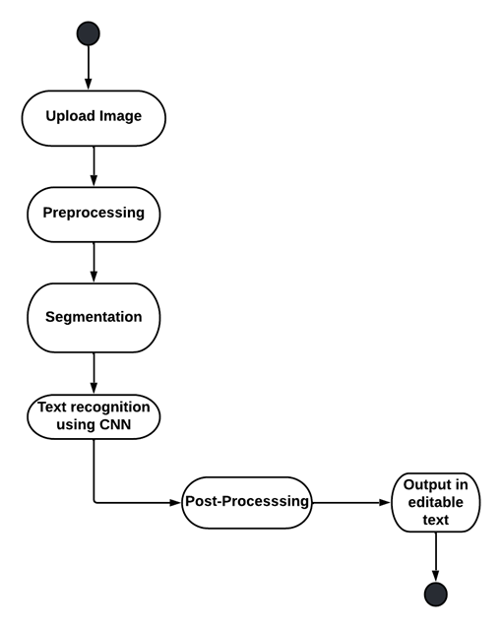
SYSTEM DESIGN

Slide 20
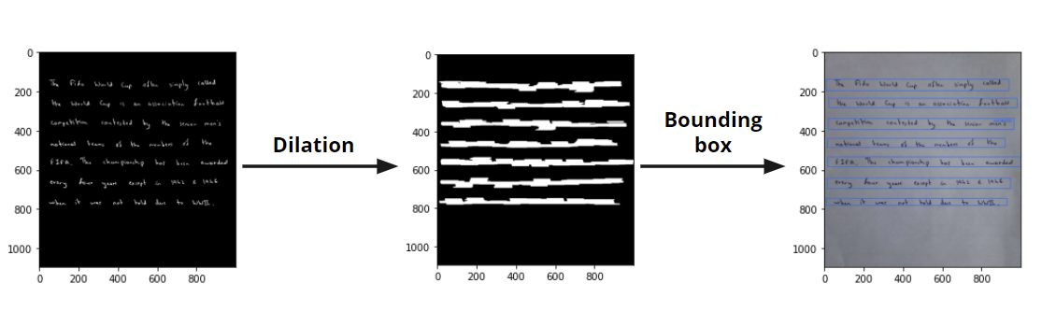
LINE SEGMENTATION

Slide 21
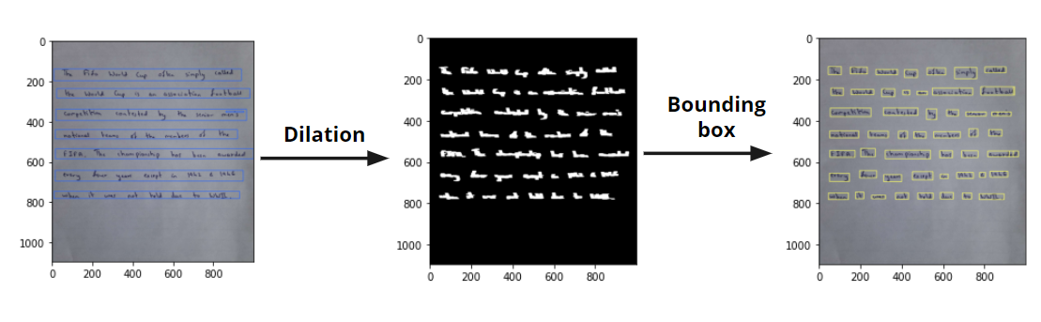
WORD SEGMENTATION

Slide 22
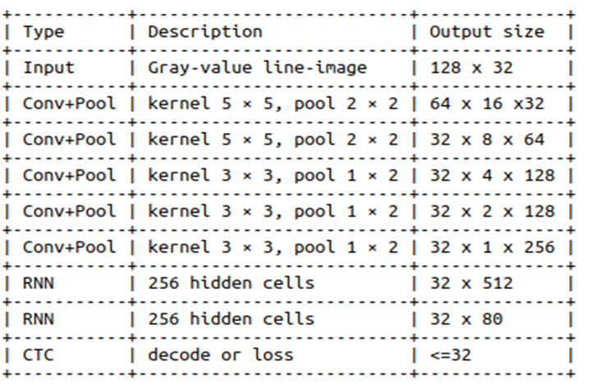
SYSTEM DESIGN - CLASSIFICATION NETWORK

Slide 23
PROPOSED SOLUTION METHODOLOGY
The image of handwritten text is received as input is segmented into lines of handwritten text.
Further segmentation of these lines to words is done.
The word images is then fed as input into a Handwritten Text Recognition system trained on word images.
The recognized output is later sent for post-processing and the required output is obtained as editable text document.

Slide 24
WORD BEAM SEARCH
It is a modification of vanilla beam search.
Words are constrained to dictionary words.
Any number of non-word characters is allowed between words.
Better running time than token passing

Slide 25
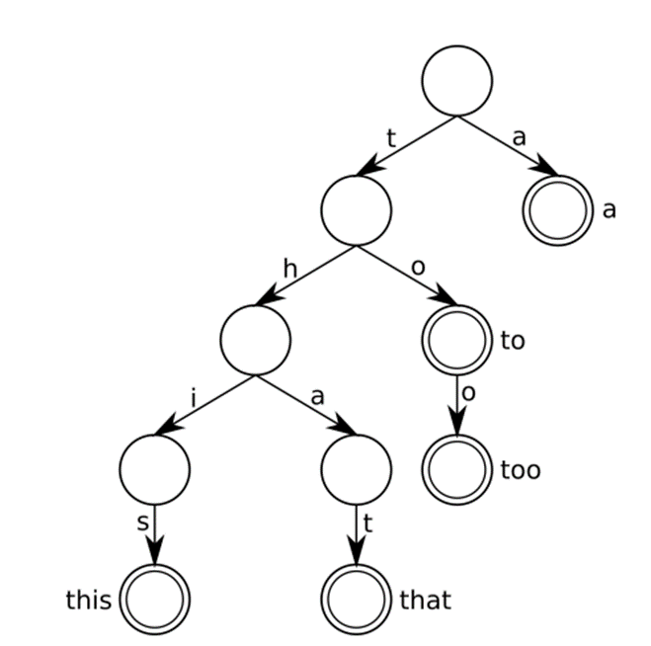
PREFIX TREE

Slide 26
IMPLEMENTATION SETUP FRAMEWORK
Hardware Requirements :
Processor : Intel core i5 and above
RAM : 8GB or above
Software Requirements :
Python -version 3.6
Tensorflow -version 2.9.1
Heroku
Flutter -version 3.7.5

Slide 27
DATASET
The dataset used is IAM Handwriting Database 3.0 word dataset.
657 writers contributed samples of their handwriting
The dataset contains 115,320 isolated and labeled words
Overall it contains 62 classes of images.

Slide 28
IMPLEMENTATION RESULTS
Observations
90.3% accuracy obtained
Recognised custom input image with decent accuracy

Slide 29
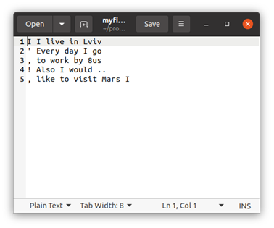
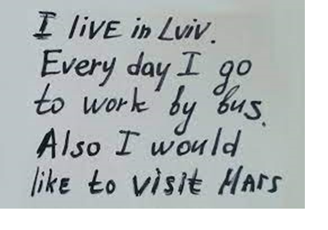
READING CUSTOM INPUT
Input Image
Recognised Output

Slide 30

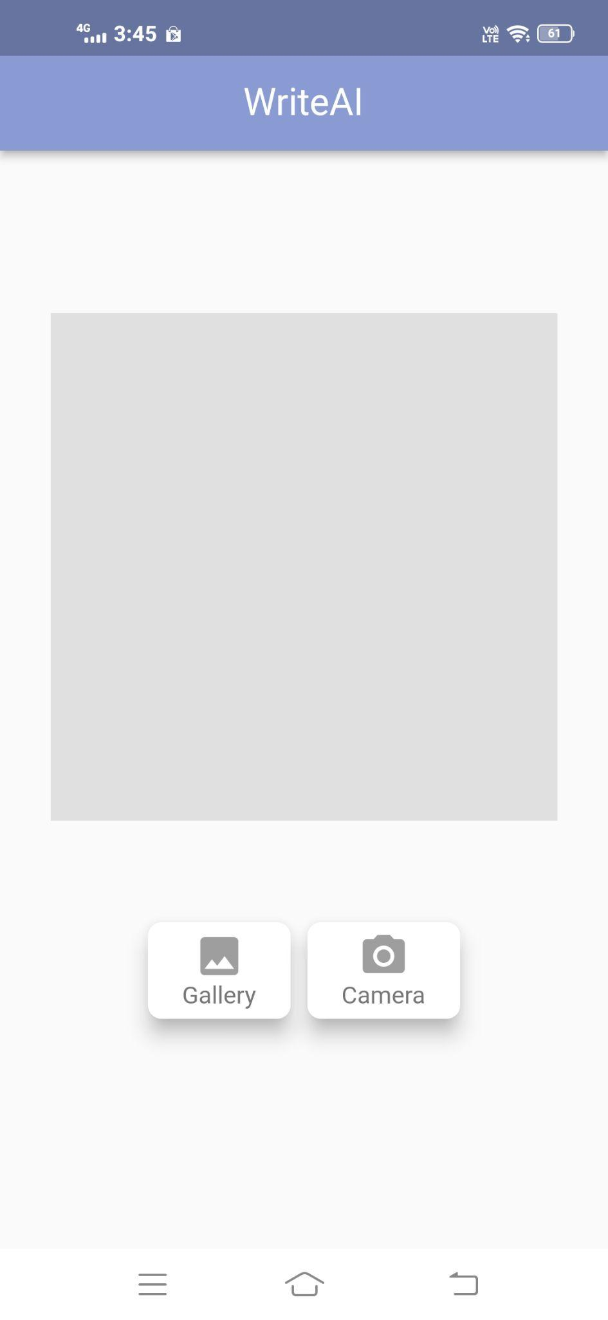
GRAPHICAL USER INTERFACE

Slide 31
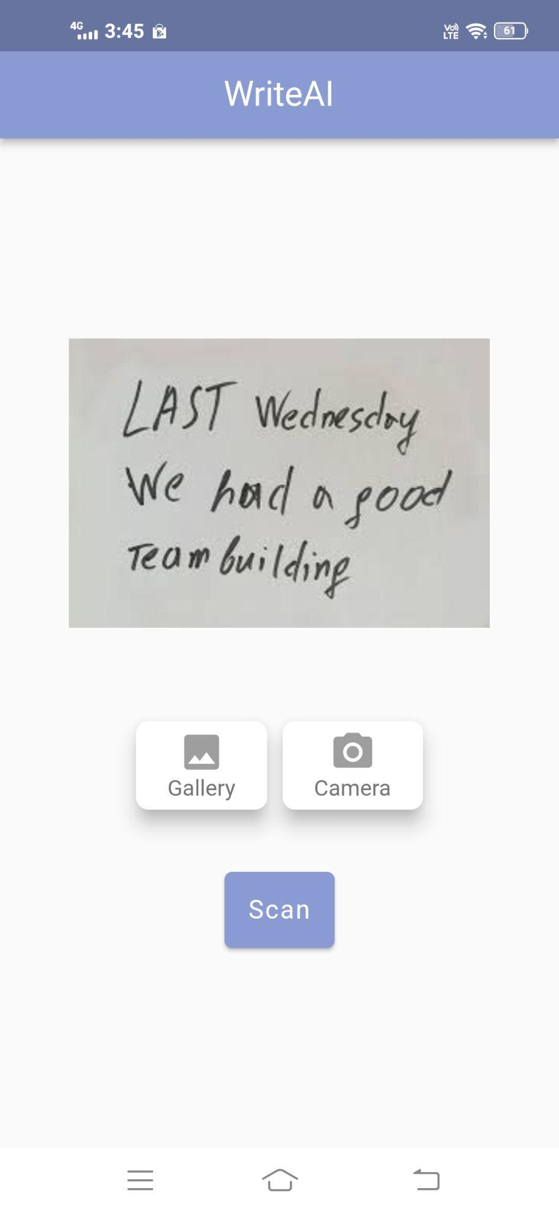
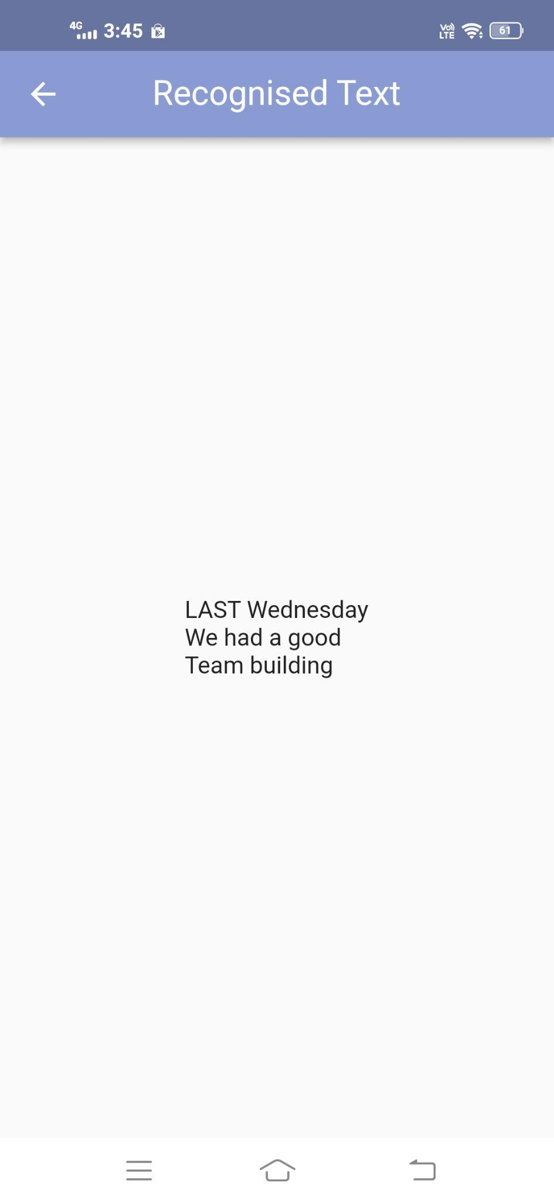
GRAPHICAL USER INTERFACE

Slide 32
INDIVIDUAL CONTRIBUTIONS
Ardra T S
Word segmentation
System testing
Fixed errors and bugs and other minor issues
Model Deployment
Krishnapriya V P
Selected the appropriate dataset
Image Preprocessing
Contributed in developing mobile UI
Connected the android application and the model deployed API.

Slide 33
Alvin Antony K
Line segmentation
Connected the android application and the model deployed API.
Contributed in developing mobile UI
Model Deployment
Allen Y
Model tuning
Developing Flutter Application
Fixed errors and bugs and other minor issues
Contributed in developing API endpoints for the mobile application

Slide 34
CONCLUSION
A mobile application is designed to provide a facility to convert written text into printed text
The model was designed using convolutional neural network character recognition
The accuracy obtained in testing phase was 90.3%.
Trained our model using a large dataset of handwritten characters to improve accuracy.
The project gives best accuracy for the text which has less noise
The proposed CNN-RNN-CTC approach for handwritten text recognition offers a powerful and effective solution
The app has the potential to be a valuable tool for users looking to digitize their handwritten notes efficiently

Slide 35
REFERENCES
Dutta, A., Handwritten Digits Recognition using Convolution Neural Networks.
N. Darapaneni et al., "Handwritten Form Recognition Using Artificial Neural Network," 2020 IEEE 15th International Conference on Industrial and Information Systems (ICIIS), 2020, pp. 420-424, doi: 10.1109/ICIIS51140.2020.9342638.
Gupta, N. and Goyal, N., 2021, January. Machine Learning Tensor Flow Based Platform for Recognition of Hand Written Text. In 2021 International Conference on Computer Communication and Informatics (ICCCI) (pp. 1-6). IEEE.
Nair, A.M., Aldo, C., Bose, B., Joseph, A., VM, P. and MJ, S.E., 2021. Handwritten Character Recognition using Deep Learning in Android Phones
Wu, Y.C., Yin, F. and Liu, C.L., 2017. Improving handwritten text recognition using neural network language models and convolutional neural network shape models. Pattern Recognition, 65, pp.251-264.

Slide 36
Hemanth, G.R., Jayasree, M., Venii, S.K., Akshaya, P. and Saranya, R., CNN-RNN BASED HANDWRITTEN TEXT RECOGNITION.
Ingle, R.R., Fujii, Y., Deselaers, T., Baccash, J. and Popat, A.C., 2019, September. A scalable handwritten text recognition system. In 2019 International Conference on Document Analysis and Recognition (ICDAR) (pp. 17-24). IEEE.
Ghosh, D., Chaurasia, D., Mondal, S. and Mahajan, A., 2021. Handwritten documents text recognition with novel pre-processing and deep learning. In 2021 Grace Hopper Celebration India (GHCI) (pp. 1-5). IEEE.
Jemimah, K., 2019. Recognition of handwritten characters based on deep learning with tensorflow. Int. Res. J. Eng. Technol.(IRJET), 6(09).
Praneeth, A.V.S.R., Pappu, L.R., Kumar, G.P., Bhatta, A.S., Chowdary, B.R. and Shishwan, G.S., 2022. Hand Written Digit Recognition Using Machine Learning. International Journal of Research in Engineering, Science and Management, 5(1), pp.59-62.

Slide 37
THANK YOU!

